Slide 1
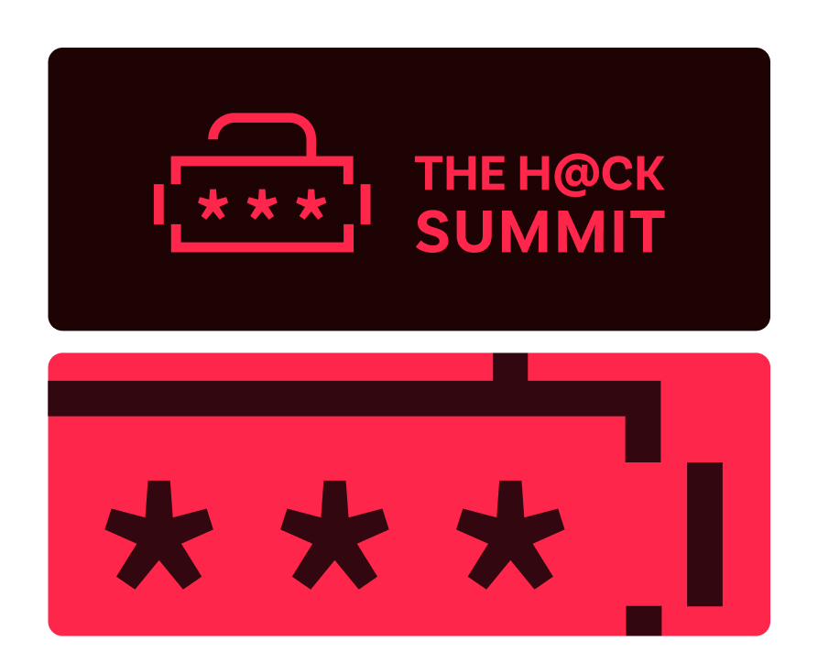
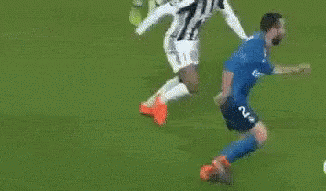
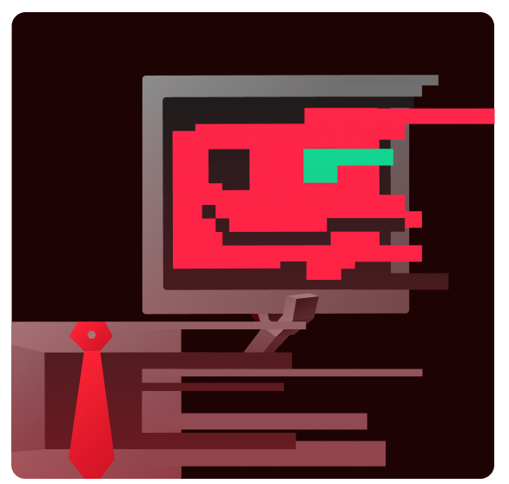
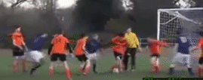
Champions League
or Sunday League?
Lessons learnt after a year with Security Champions program
Mateusz Trójczak
André Loras Leite
Development Security & DevSecOps
@ISS A/S
Event organized by: Academic Partners Foundation
Notes:
M & A

Slide 2
>_ whoami whoarewe
Combined 18+ years in IT
Mostly IT security
Last few years focused on AppSec
Established Security Champions communities
from scratch in:
  Portuguese medical software startup
  Non-IT international corporation

Slide 3

Intro
Notes:
A

Slide 4
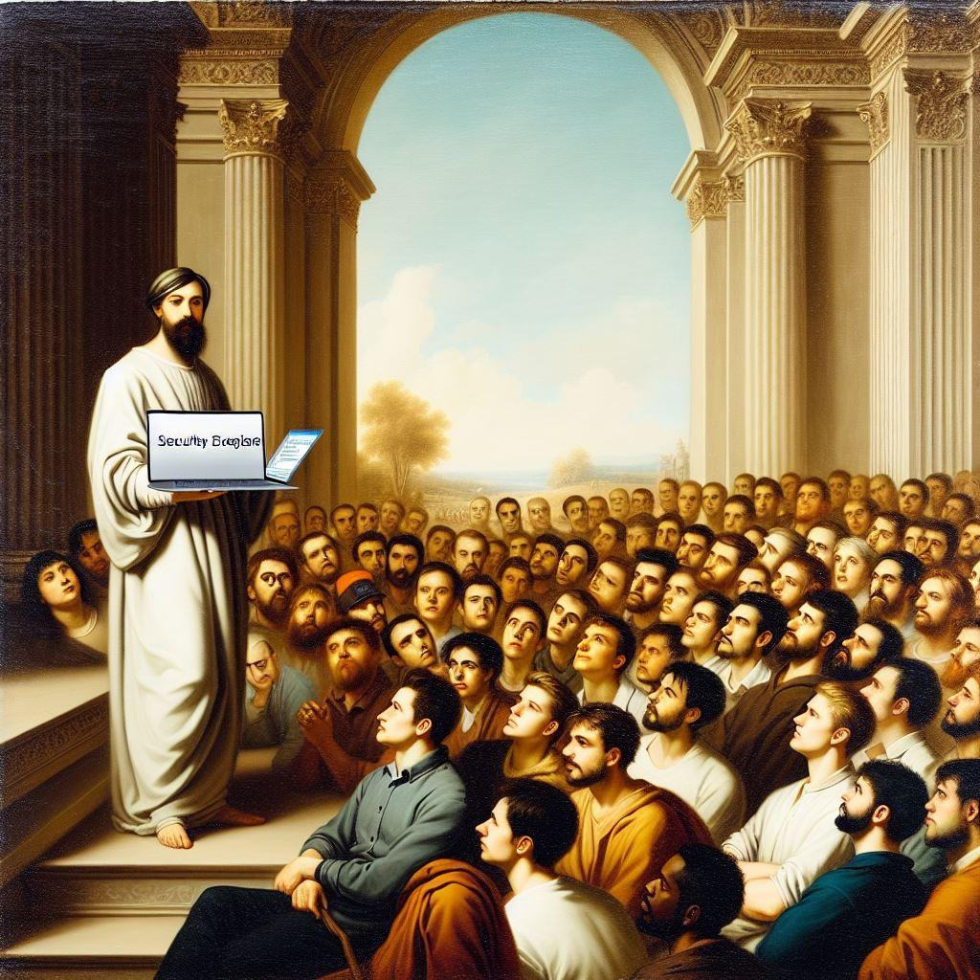
>_ whois SecurityChampion
Member of developing team
Skilled in their team’s tech, knowing the project well
Having security focus – devoting e.g. 20% of their time
Bringing the “Sec” to “DevSecOps”!
Closely aligned with InfoSec team.
Receiving extended training and communication
<script>
alert(xss)
</script>
‹#›
Notes:
A

Slide 5

>_ Security Champions program
A community of Champions from multiple teams,
who regularly meet and communicate with InfoSec
& each other to:
  Spread security awareness
  Share knowledge with developers
  Co-create secure coding best practices, secure defaults...
  Lead:
    Security code reviews & consultations
    Threat modeling for new features
  Consult on implementing and tuning security tools
  (e.g., scanners, WAF)
  Help prioritizing vulnerability fixes.
‹#›
Notes:
A

Slide 6

Prepare for the kick-off
Notes:
A

Slide 7


>_ Security Champions models
Which way should we follow?
MVP
(include only selected)
Scope
ALL-IN
(include also additional)
Web
DevOps Platforms
Tech Platforms
Cloud
Automation
Mobile
Embedded
Tech
Big Data
Integration
IAM
Backend
DevOps
Architect
Product Owner
Roles
Fullstack
Frontend
QA
Project Manager
Seniority
Lead
Senior
Mid
Junior
Intern
Interest
VolunTOLD
Volunteer
Notes:
A

Slide 8

>_ Our Champions
10 members
    8 different dev projects: web, DevOps, technical platforms (IoT, Kubernetes, integration, Big Data)
    Various roles: Full stack, Backend, Frontend, DevOps, Dev manager
    Seniority: Mostly Mid and Seniors
    Diverse group: from many different countries
    Mostly volunteers
But also…
  7 members
    5 different dev projects: Web, DevOps, Hardware, Mobile, Data
    Various roles: Full stack, Backend, Frontend, DevOps, Data Engineer, Dev Manager
    Seniority: Mostly Mid and Seniors
    PT
    Mostly VolunTOLD
‹#›
Notes:
A

Slide 9

>_ Goals & Milestones – examples
Charter – vision & mission 1-pager
Short term (~3 months)
  Champions upskill in key security areas
  Increased involvement in the Vulnerability Management process
  <security tool / practice> adopted by each team & biggest findings remediated
Mid term (~6 months)
  Secure coding standard created, and secure defaults established
  Proactive security culture
Long term (~1-3 years)
  Security “by design” in all stages of software development
  Continuous and proactive remediation of new vulnerabilities
‹#›
Notes:
A

Slide 10
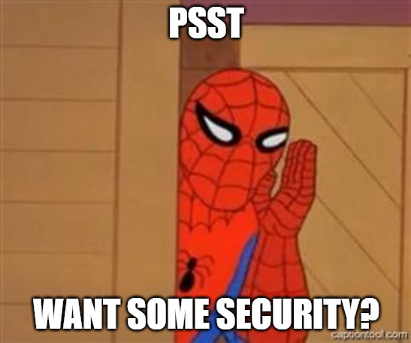
>_ Selling the program
‹#›
Notes:
R
M

Slide 11
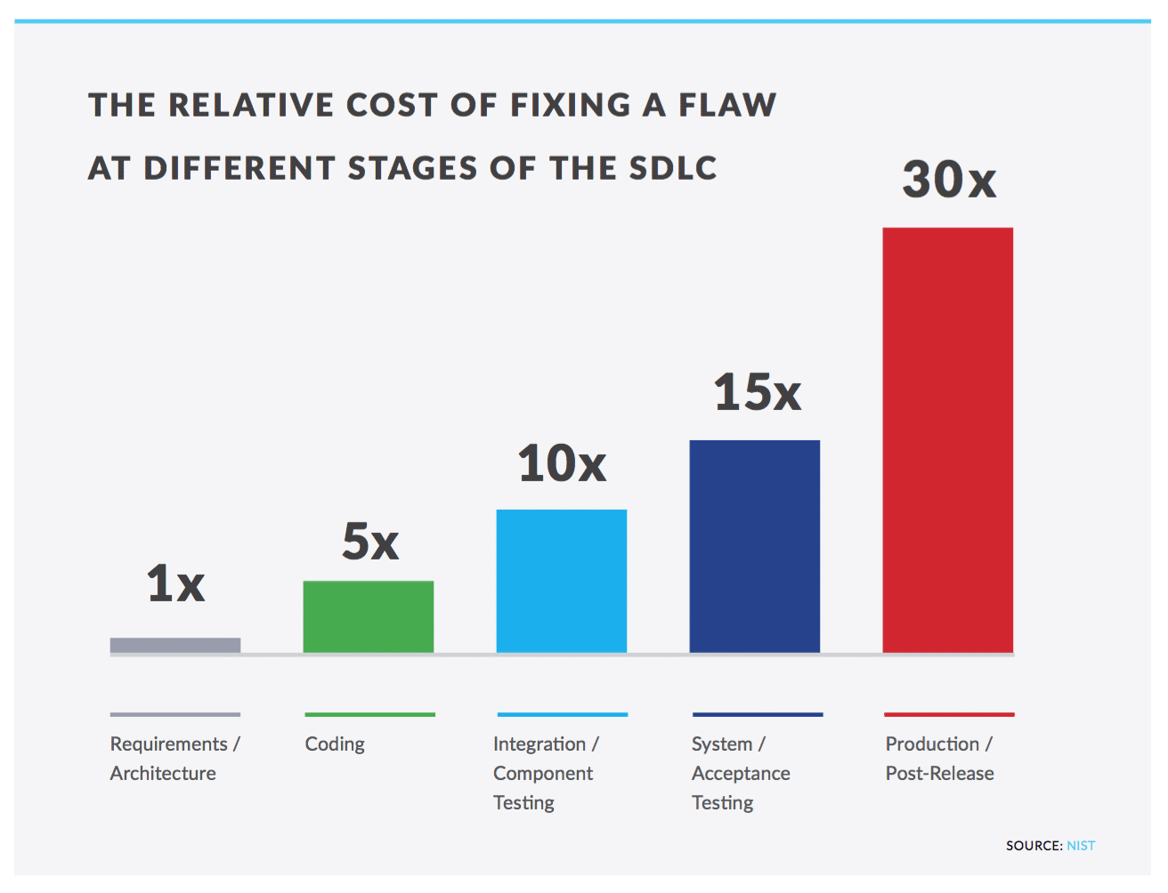
>_ Buy-in: Management
    Easy with Security management.
    Development management. may be harder to convince (org culture!)
      Costs? Nah, investment ;)
      Less friction with InfoSec
        Extra requirements (last minute)
        Approvals
      🡪 Secure-by-design process –
      protect before development
‹#›
Notes:
M

Slide 12
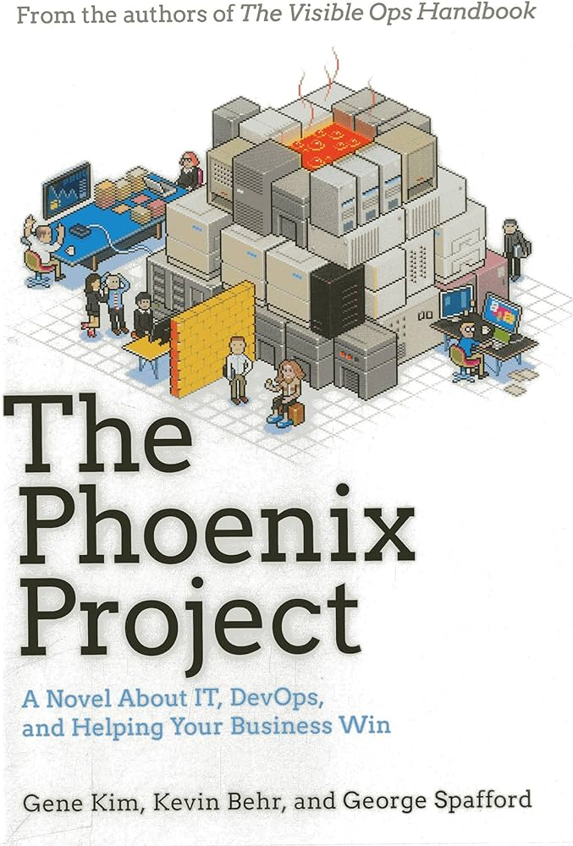
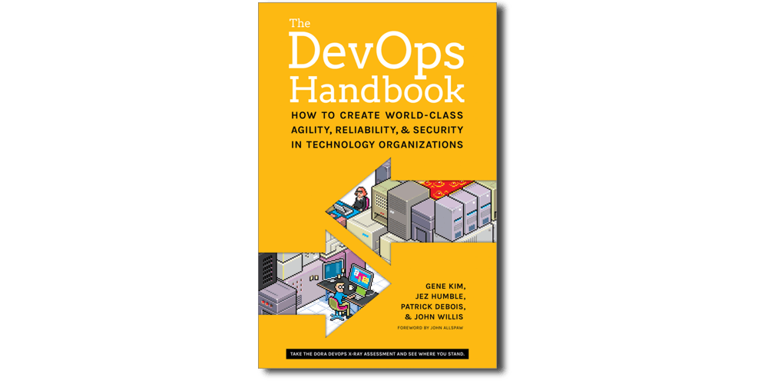
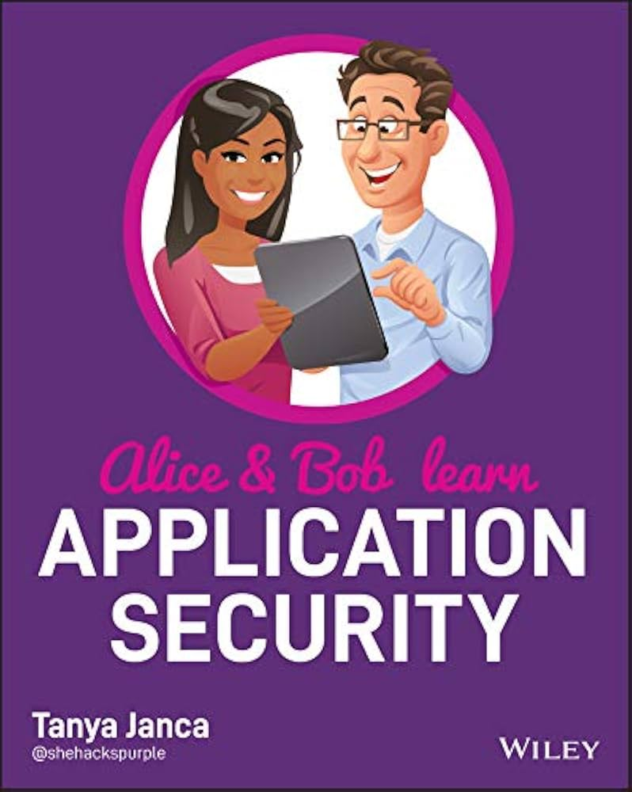
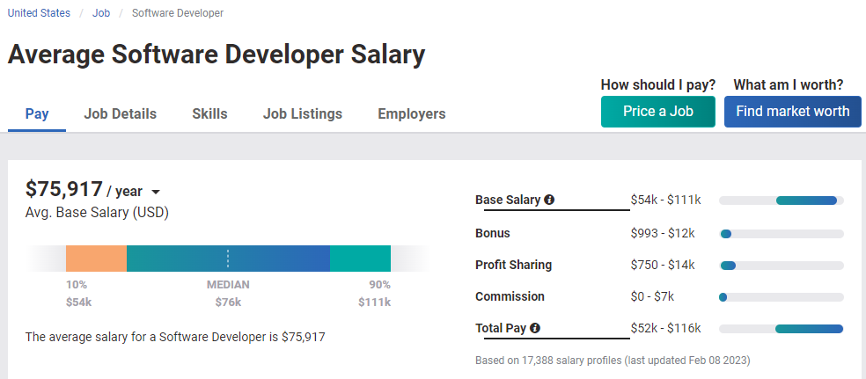
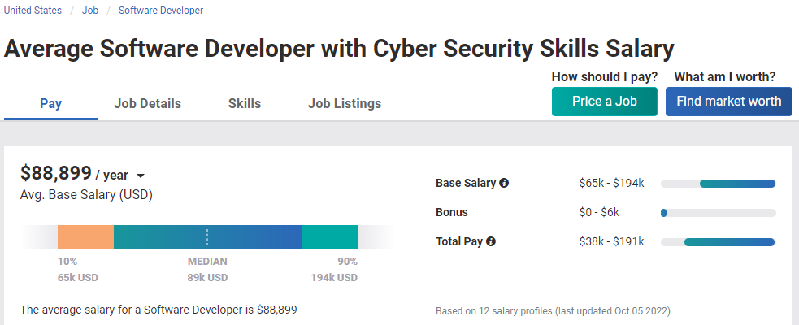
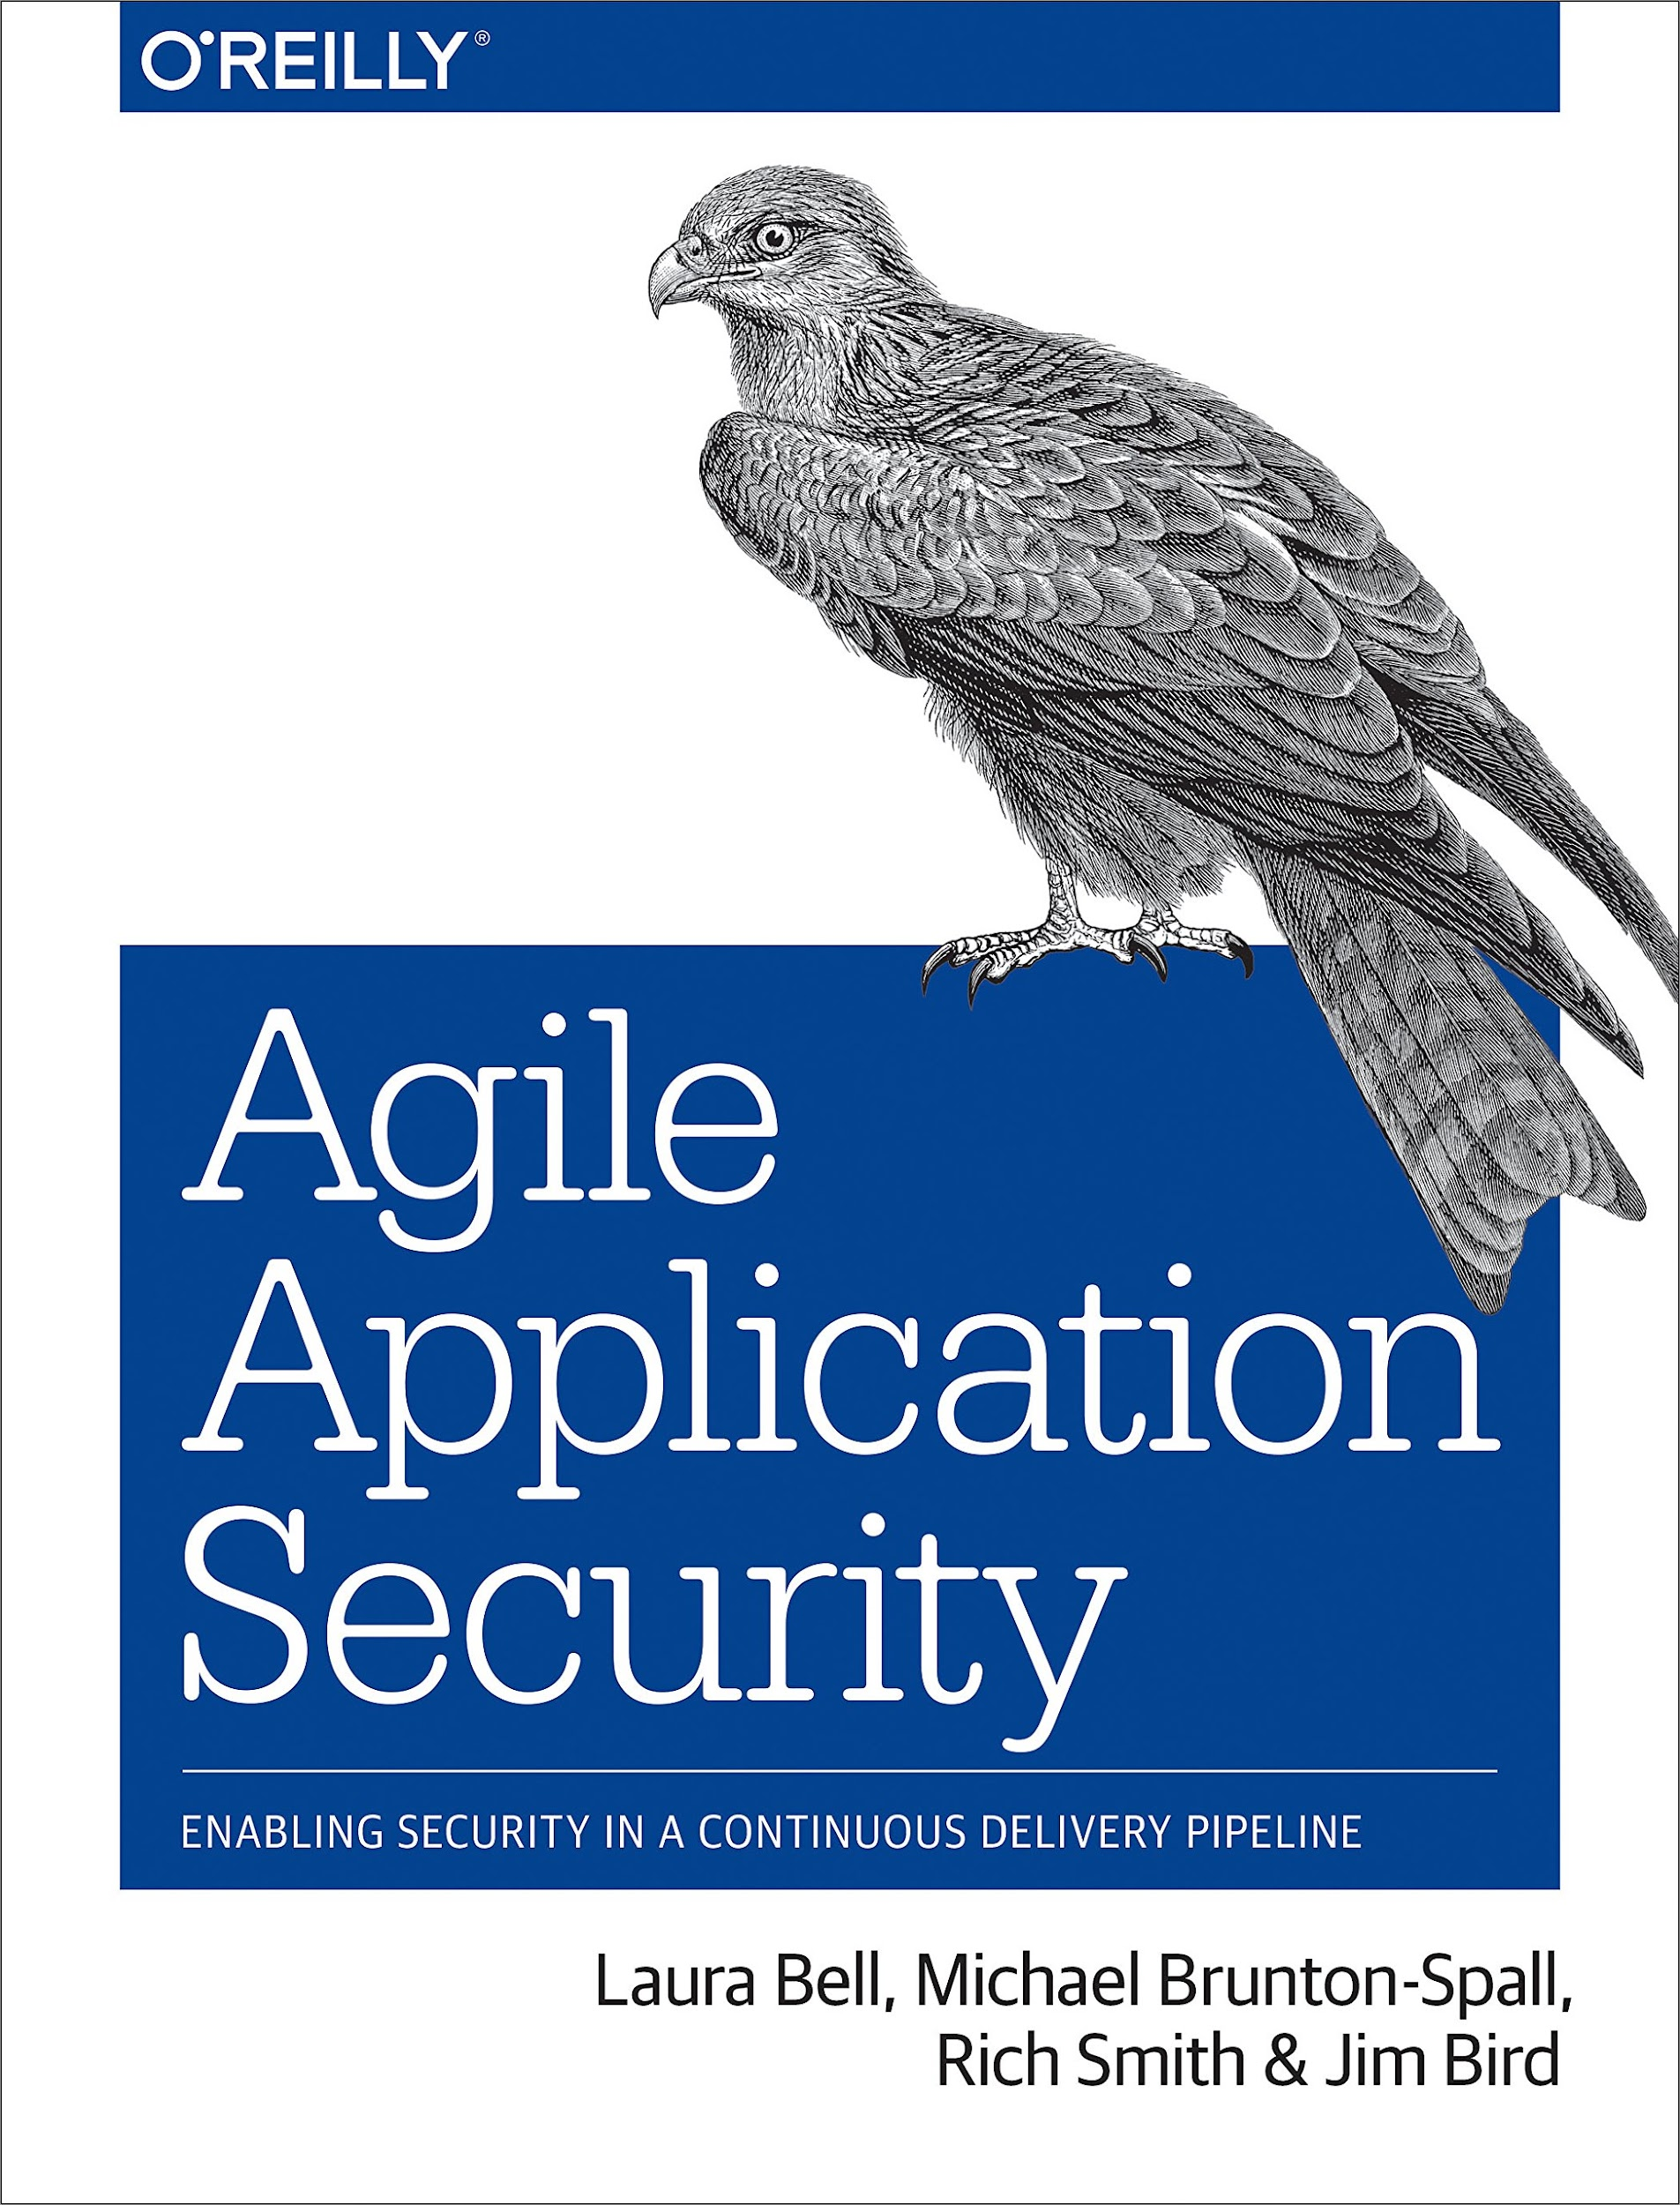
>_ Buy-in: Developers
    Free trainings (upskill )
    Visibility – among team & company
    SWAG, books, conferences
    Higher value on the market $$$
Source: Payscale
‹#›
Notes:
M

Slide 13
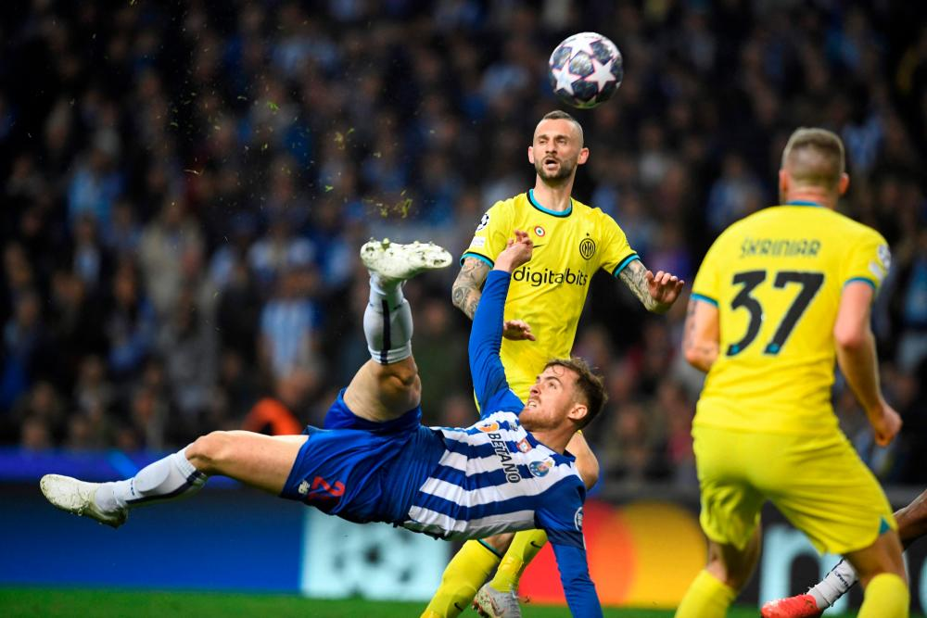
Playing the league
Notes:
A

Slide 14



>_ Comms & Meetings
  Communication channels - choose the tool developers use
    Group communication
    Security news
  Champions group meetings
    In person vs. remote
    All together first
    Focused on particular applications
‹#›
Notes:
A

Slide 15

>_ Trainings
Security foundations
Security team(s) & their craft
AppSec:
  OWASP Top 10 & Cheat sheets,
  DevSecOps, Threat Modeling
  Attack demos
  Hands-on workshops, CTFs
‹#›
Notes:
A

Slide 16
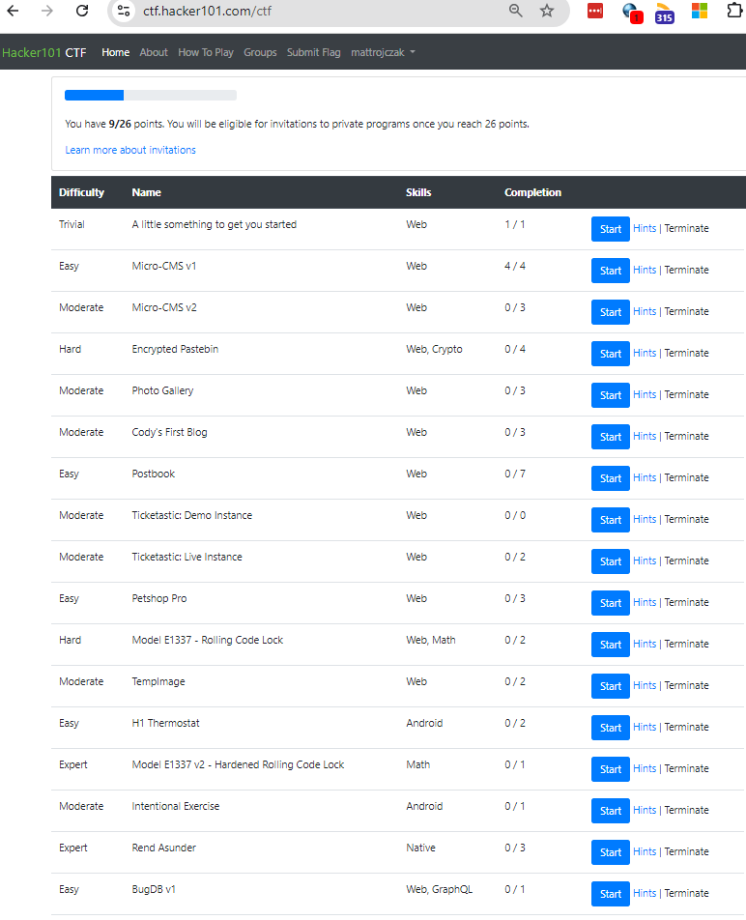
You’re too busy, huh?
That's not an excuse.
There are plenty of prepared CTF platforms
‹#›
Notes:
A

Slide 17
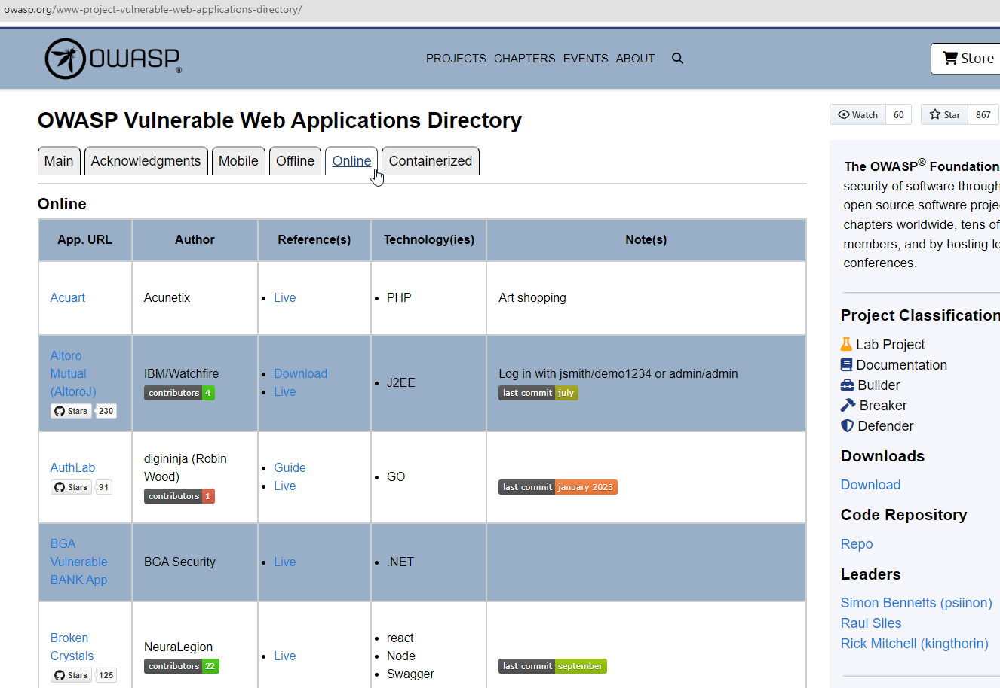
There’s more…
OWASP Vulnerable Web Applications Directory
‹#›
Notes:
A

Slide 18
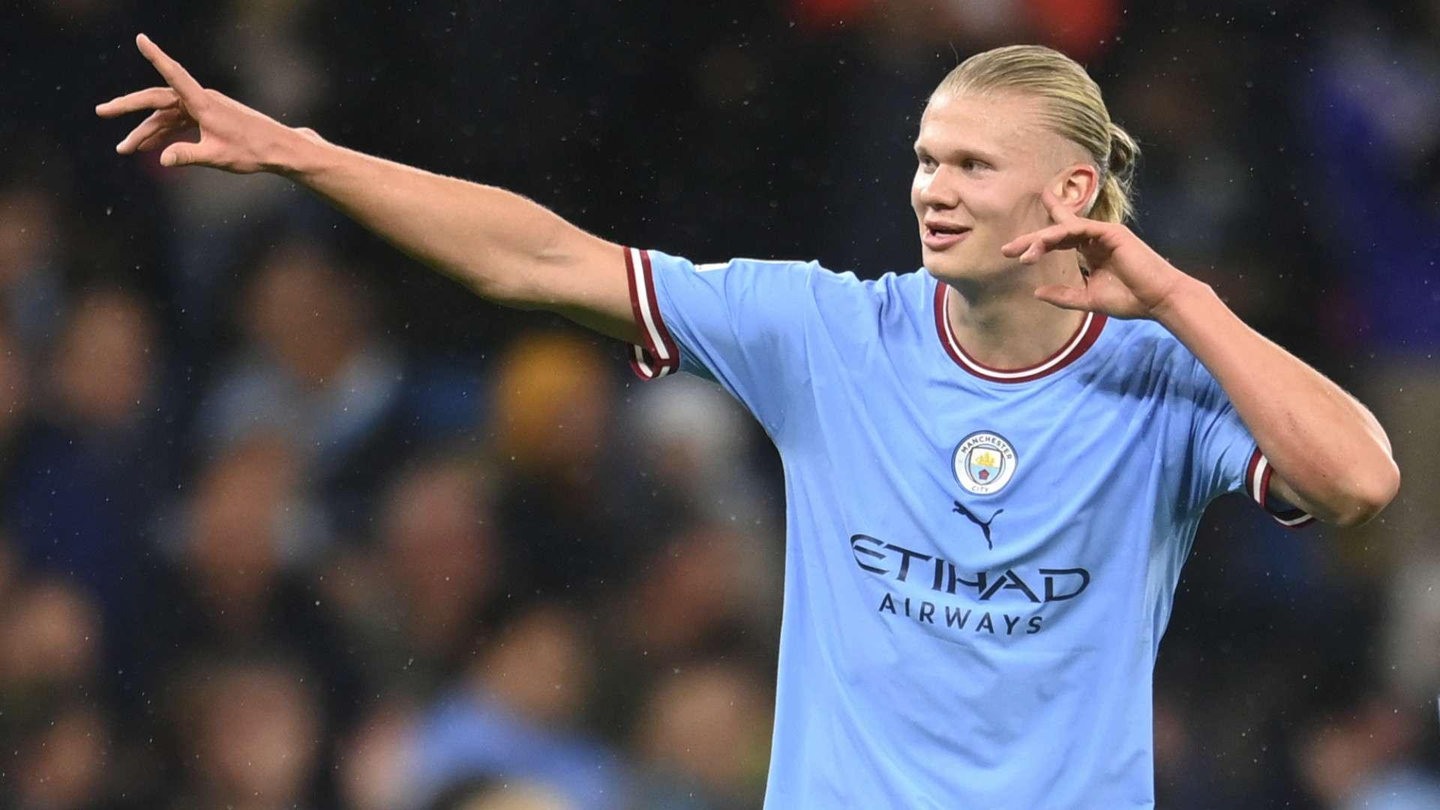
Goals scored
Notes:
M

Slide 19

>_ What went well?
  Almost instant uptake of security fixes
  Relationships with Champions (& their teams)
  Proactivity – devs asking for a consult… or a pentest (sic!)
  Less new issues
  Face to face meetings
‹#›
Notes:
M
Relantionship – get to know developers from every team, especially champions that you meet with regularly, but also, through ripple effect, from their teams – they redirect people to talk to you

Slide 20
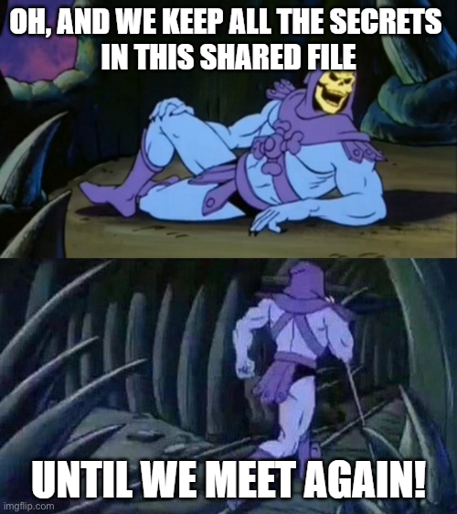
>_ Your very own… network of spies
Visibility
‹#›
Notes:
M
Private account & device used to access app
cloud resources (Home IP whitelisted on NSG ☺)

Slide 21
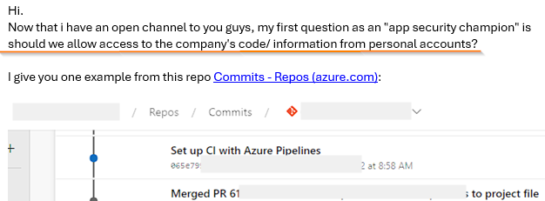
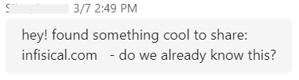
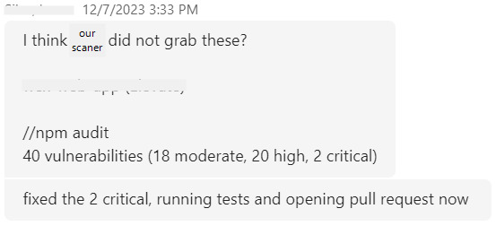
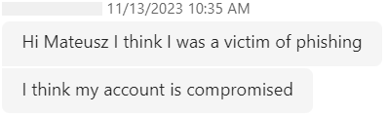
>_ “Can I show you something?”
Proactiveness
  Man, we’re using this unenrolled laptop
  with openvpn to connect to our devices. Is it ok?
‹#›
Notes:
M
Private account & device used to access app
cloud resources (Home IP whitelisted on NSG ☺)

Slide 22
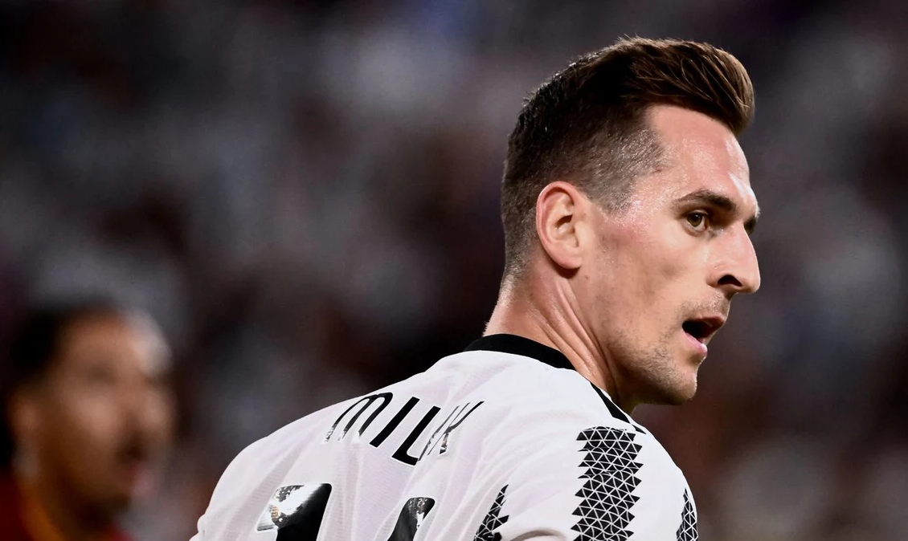
Missed
Opportunities
Notes:
M

Slide 23

>_ What DIDN’T we get so right?
  Expectations
    All Champions driving topics long term
    – you still must lead them
    One cannot become a security expert overnight
    Time reserved for security
    - need to compete with business requirements
‹#›
Notes:
M

Slide 24
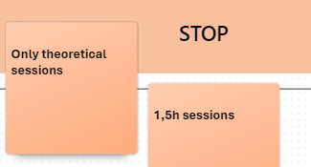
>_ What DIDN’T we get so right?
  Too much theory in the beginning, too long sessions
  Newsletter – a lot of effort, not much return
  (better approach: recommend AppSec influencers to follow)
‹#›
Notes:
M

Slide 25

Post-season analysis
Notes:
A

Slide 26

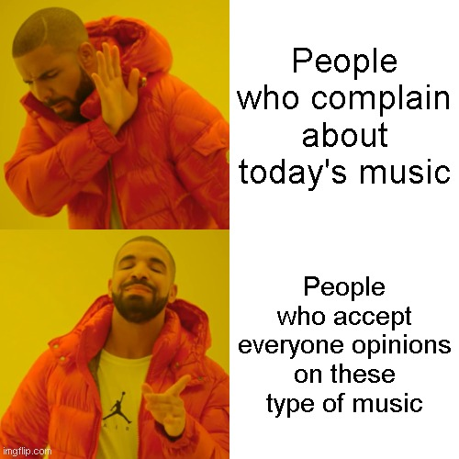
>_ Key takeaways
Kick-off & forget
Treat Champions as your subordinates
Expect AppSec issues to magically disappear
Dwell on theory and academic discussion
Do everything yourself
Treat the program like a plant
Become a trusted partner
Proactively identify, address and prevent
Make it interactive
Involve other people to deliver content
‹#›
Notes:
A

Slide 27

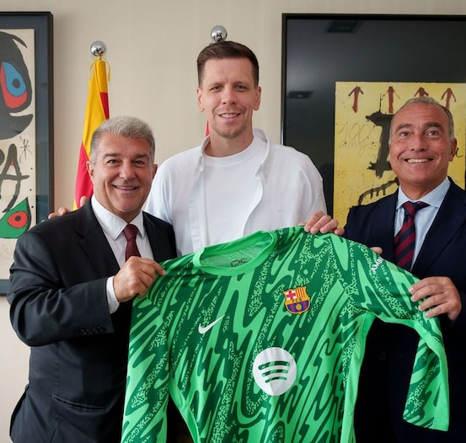
What’s next?
Notes:
M
Ok, so after hearing all the stories, the good and the bad, you may be wondering:
Are we going to RETIRE the program or push it to new heights? ☺

Slide 28
>_ Fate of the Program
  Not everything went quite as well as we planned…
  It’s been quite some effort…
  BUT…
  We DO see the value and we’re planning to expand the initiative.
  Recruiting new Champions
  Expanding to Architects, maybe QAs
  Champions to share knowledge themselves
  Include a reward system
  More concrete ROI measurements as we mature
‹#›
Notes:
M

Slide 29
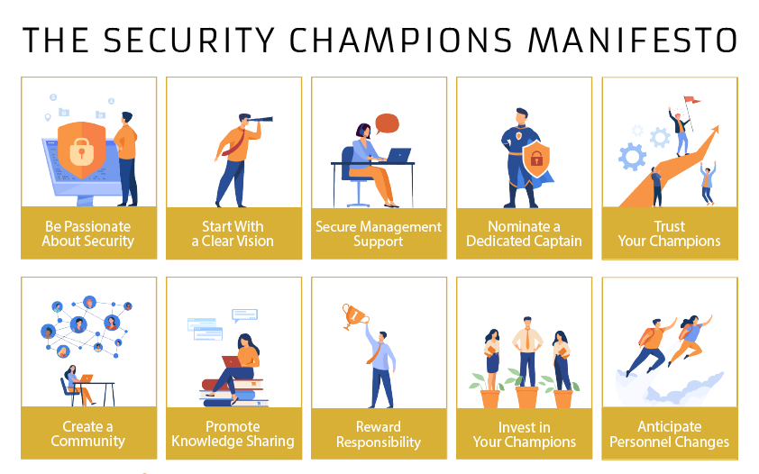
>_ How to start?
OWASP on Security Champions:
Playbook (step by step instructions)
Manifesto (10 principles)
‹#›
Notes:
M

